Slide 1
Home remedies in Shakespeare’s time
Store cupboard ingredients for common illnesses

Slide 2
Home help
If you were not from a rich family then it was likely that you wouldn’t have been able to afford to visit a ‘physician’ in the sixteenth or seventeenth century. You might have been taken to a charitable hospital if one was nearby but most likely you would have been looked after at home.
It was expected that the woman of the household would know about using some herbs and plants to create remedies for common ailments such as sore throats or cuts and grazes. She would buy the ingredients from an apothecary or grow her own at home.

Slide 3
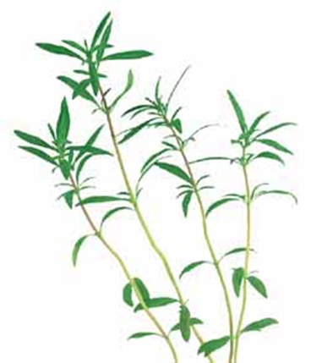
Home remedies
A lot of herbs that we might use in our cooking today were used in home remedies in the past. See which ones you recognise.
REMEMBER, it’s not safe to pick or taste plants and herbs without the help of a grown-up.
Savory
The leaves and stem of this herb can be used to make medicine that helps with stomach problems and coughs. If you are stung or bitten by an insect, you can put this herb on your skin to make it feel better.

Slide 4
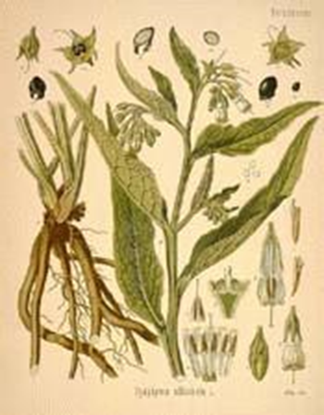
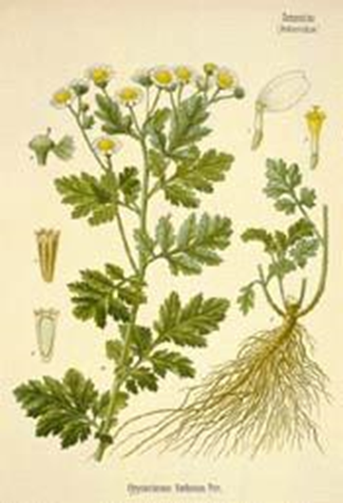
Home remedies
Comfrey
In the past, this herb was called knit bone. It can be used to help mend broken bones and heal wounds.
Nowadays people know that too much of this herb can be bad for your liver.
Feverfew
The dried leaves of this herb can be used to make medicine. People take feverfew to help with fevers, high temperature and headaches.

Slide 5
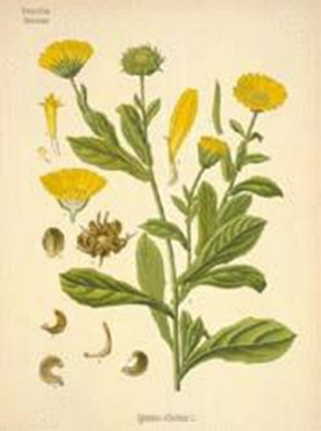
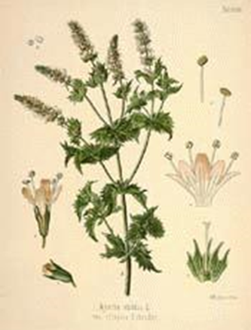
Home remedies
Marigold
The heads of these flowers can be used to heal wounds and cuts.
Mint
For thousands of years, mint has been used to help with upset stomachs and indigestion.

Slide 6
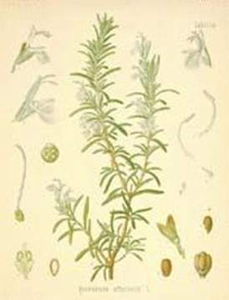
Home remedies
Rosemary
For hundreds of years, Rosemary has been used to help with muscle pain. It can also be used to promote hair growth.
Activity suggestion
Work with a partner and take turns to tell each other about a pretend illness you have. Your partner should use their knowledge of herbs to write a prescription for you.
REMEMBER – you should never pick or taste herbs or plants without checking with a grown up first.

